Slide 1
Apartments in the USA
Ali McCondichie, Kim Khue Nguyen, Leonardo Rodrigues Rodriguez, Seven George, Tyler Beringer

Slide 2
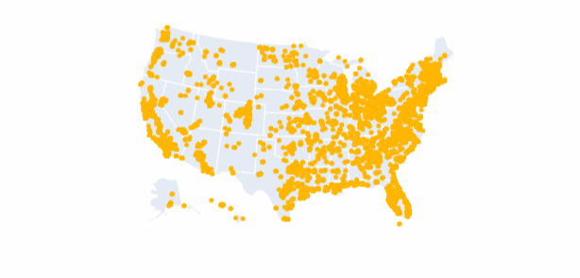
Our Dataset
We analyzed the Kaggle dataset Apartments for Rent Classified. It has:
100,000 entries
Data on price, bed, bath, location, etc.
Clean data that was improved upon
There are many practical uses for a dataset like this!
Renting an apartment is a common experience for most people at some point in their lives. This research aims to explore price variations across the United States and uncover insights about trends and patterns in rental pricing.

Slide 3

Objective
Analyze our data to find most important factors to customers when they are renting for apartments.
We will attempt to answer the following questions:
Seasonal Trends
Regional Variations
Value
What is more important to renters - more bed/bath or more square feet?
Are there any trends in apartments prices throughout the year?
How do apartment prices vary by state and by city?

Slide 4
Question 1:
Are there any trends in apartment prices throughout the year?

Slide 5

Feature Engineering:
Create a column to sort by seasons
Ability to see seasonal trends
Winter and Fall have the most data
Fall and Spring have the highest average rental price

Slide 6
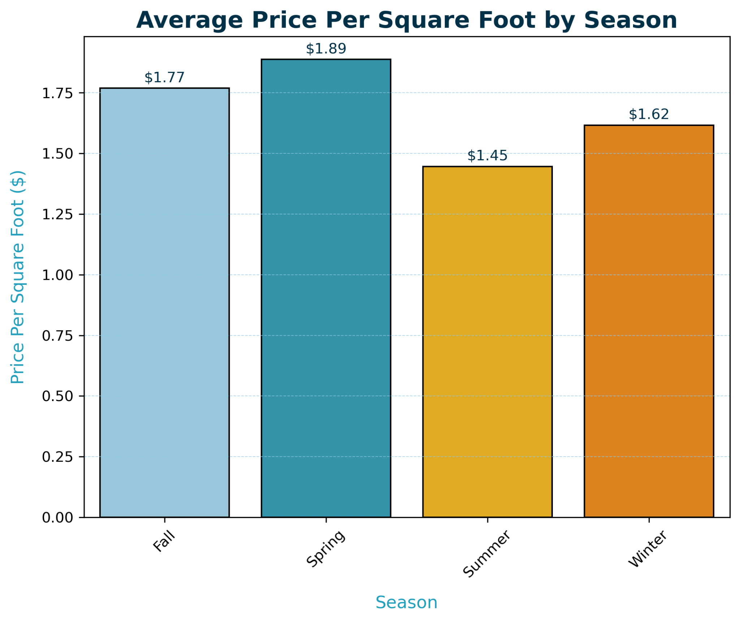
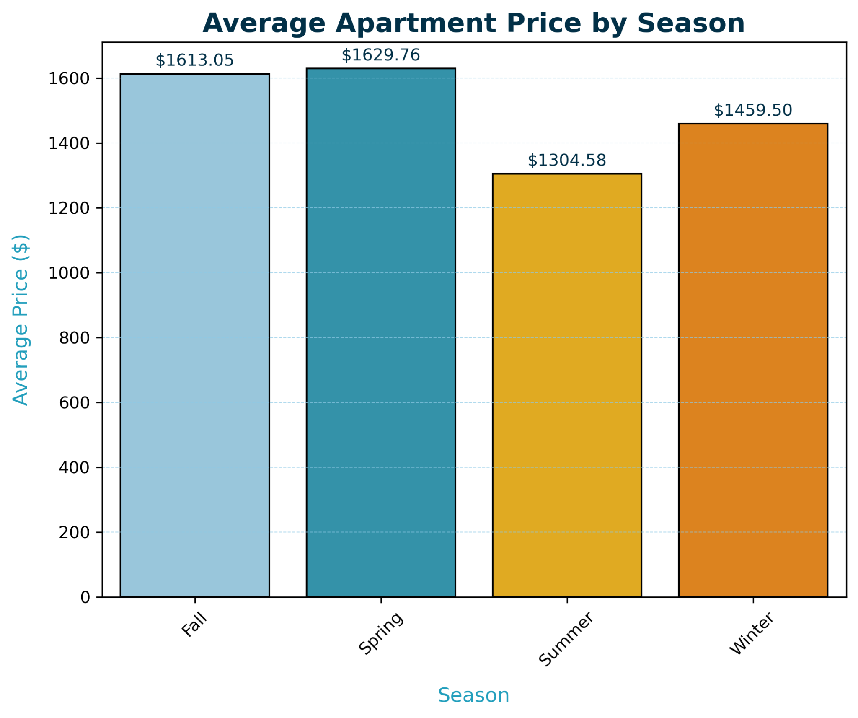
Seasonal Trends: Price per square foot vs Rental Price
Key Insights
Demand is HIGHEST in Spring and Fall
Best value for size is during Summer when demand is low
Notes:
Spring has the highest seasonal averages with $1.89 per square foot and $1629 monthly rent, and it also has the smallest number of listings in our dataset. So, that would suggest that the demand is highest in the spring when the vacancies or availabilities are lowest. To renters, avoiding apartment hunting during spring would be a smart move. Waiting until summer when the average prices are lowest with a little more availability to choose from would be ideal. Also, the price per square foot is at the lowest point of the year during summer so renters get the most value per square foot.

Slide 7
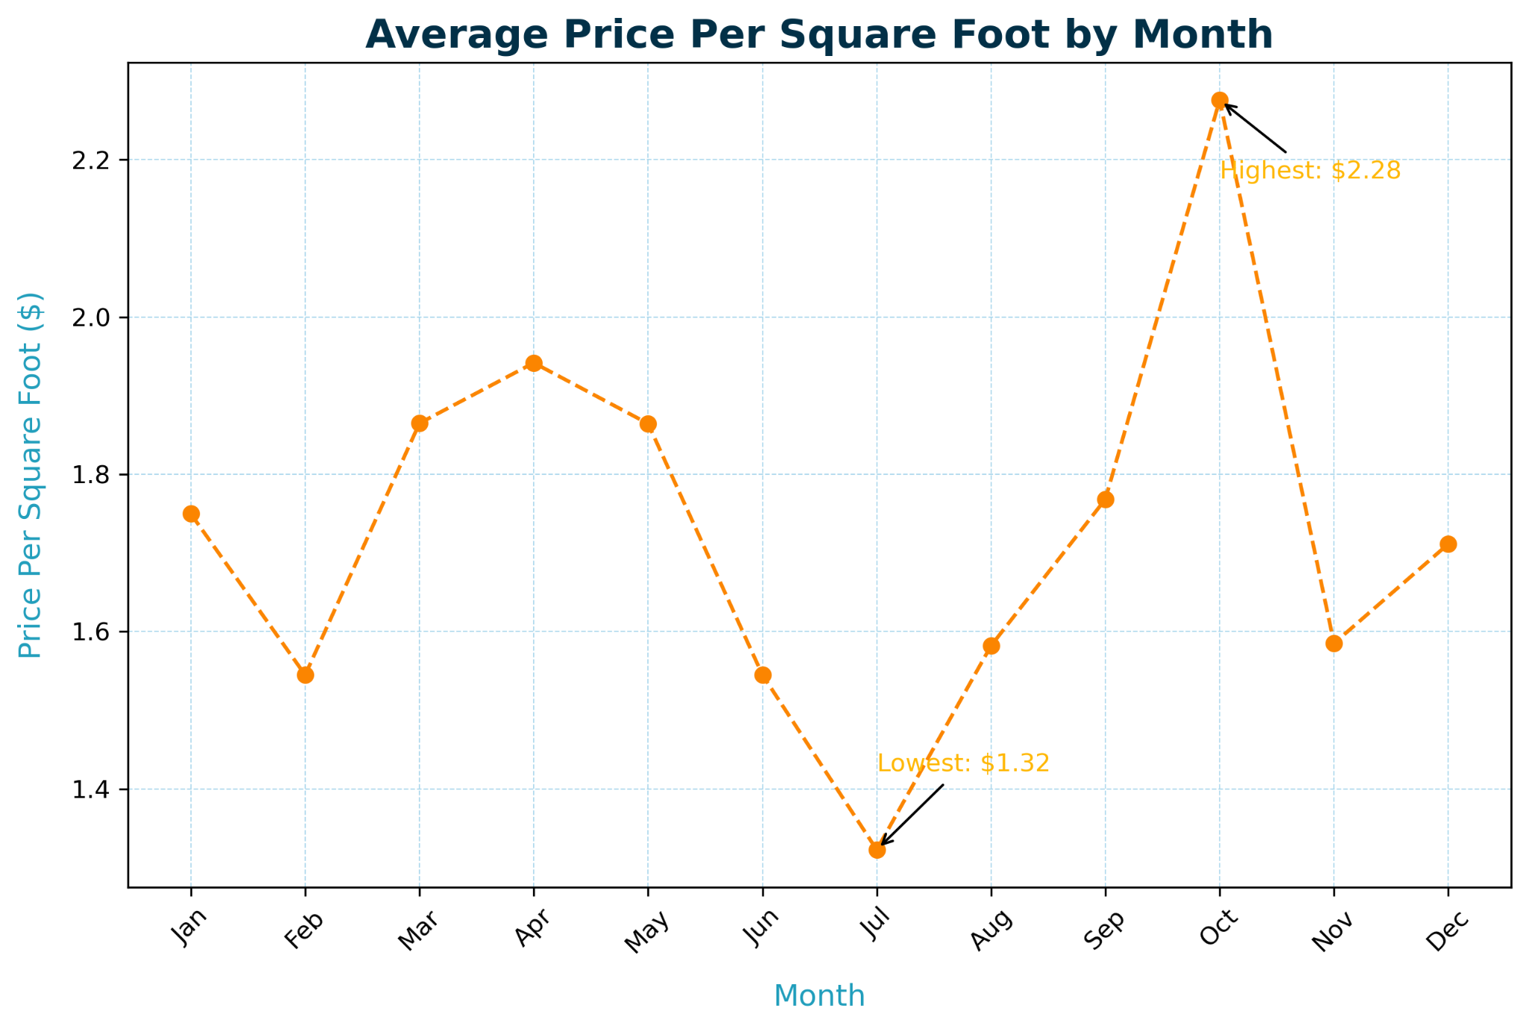
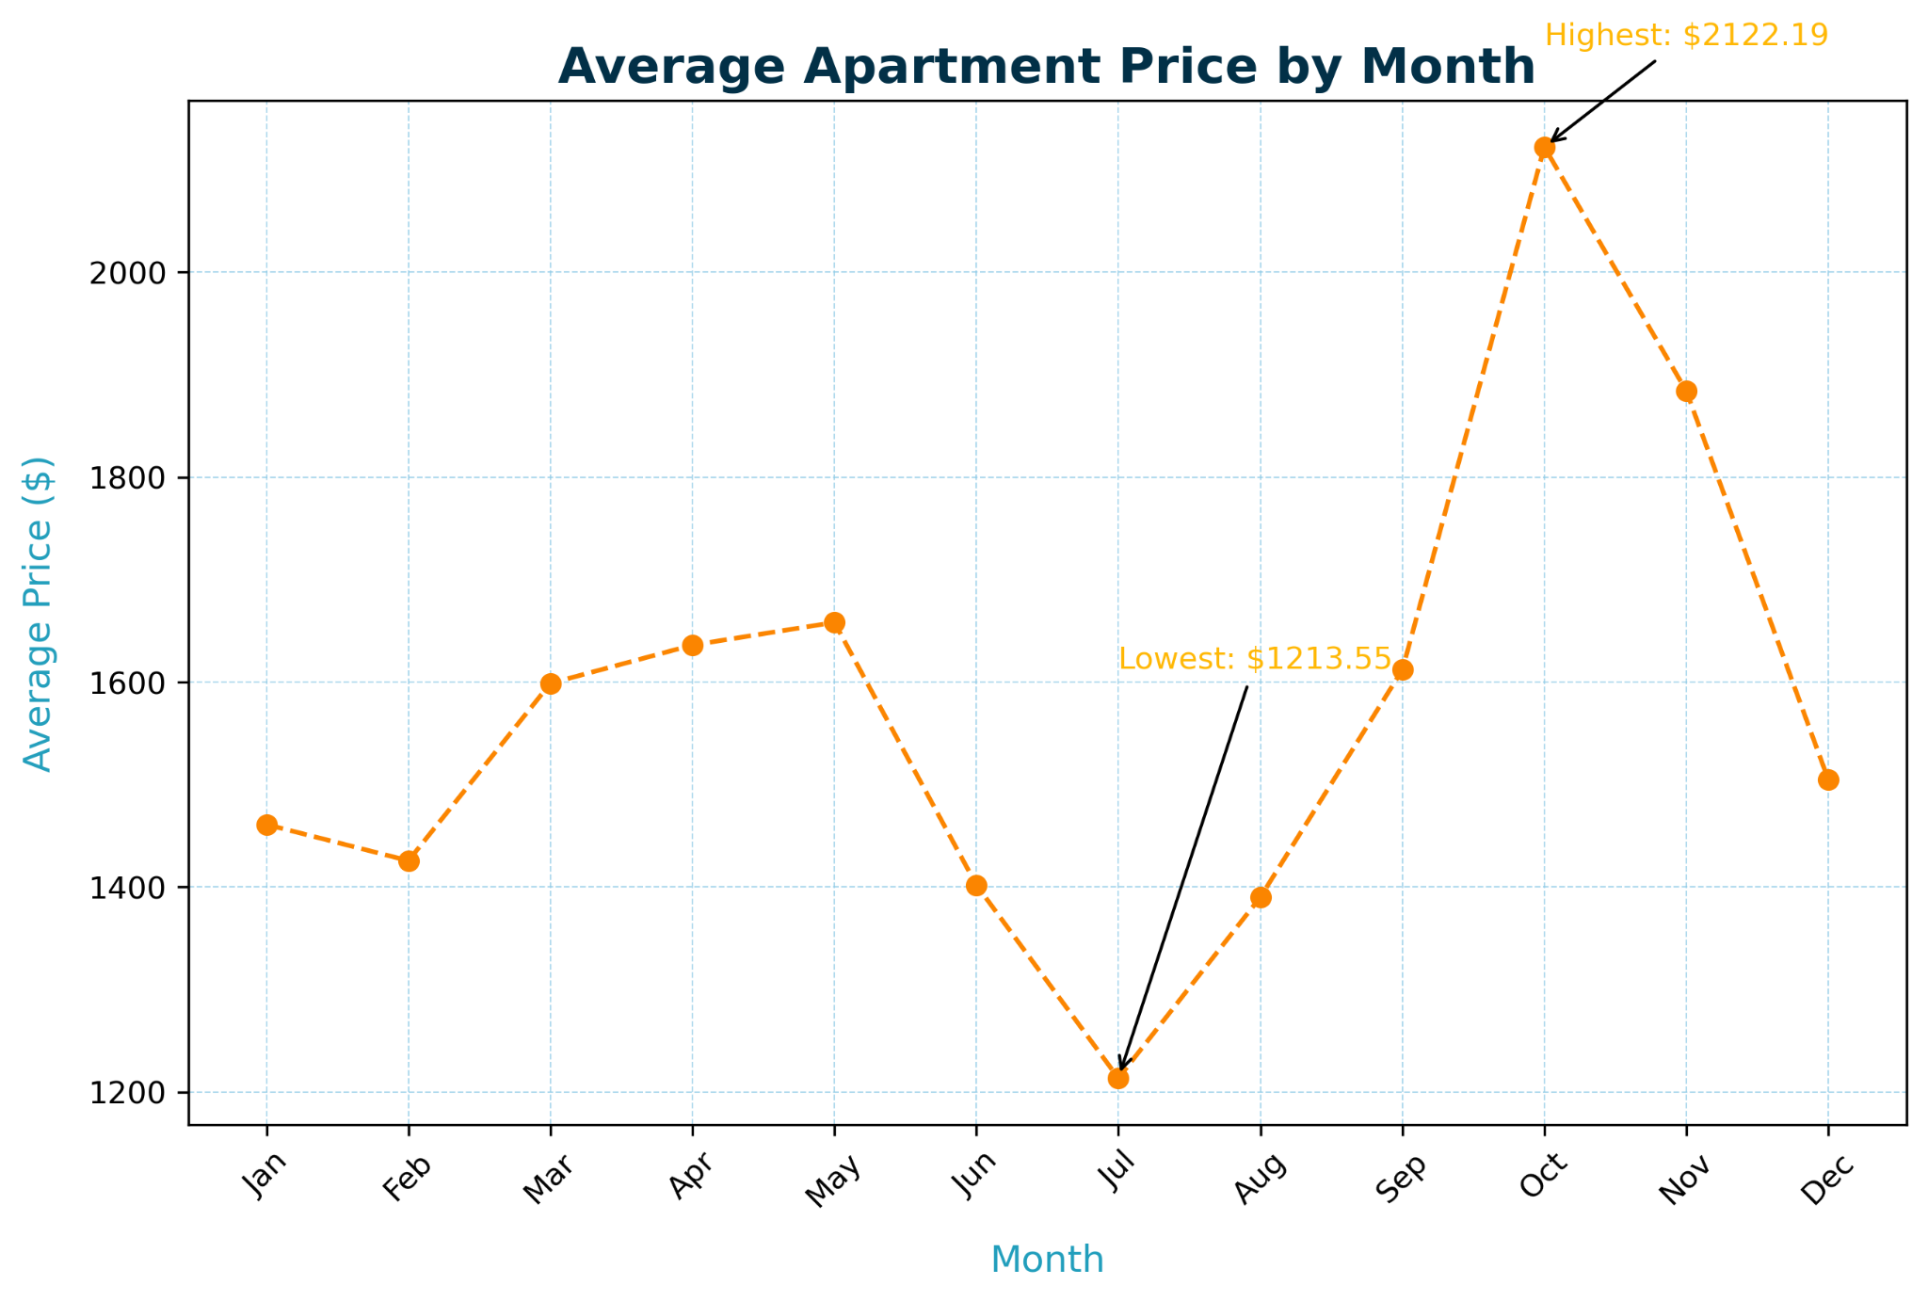
Monthly Trends: Price per Square Foot vs Rental Price
Key Insights
Demand is HIGHEST in October
Best value for size is in July when demand is low
Notes:
Now that we’ve seen what seasonal averages look like, we can look at monthly averages to narrow down even further which specific months have the highest and lowest averages. Even though spring was the most expensive season throughout the year with the least availability, October is actually the most expensive in terms of price per square foot and average rental price by far! Fall has quite a bit of availability with over 43,000 listings in our dataset in contrast to summer, which is less than 1,000 listings. In summer, the month of July holds the least expensive averages prices for both square foot and rental price.

Slide 8
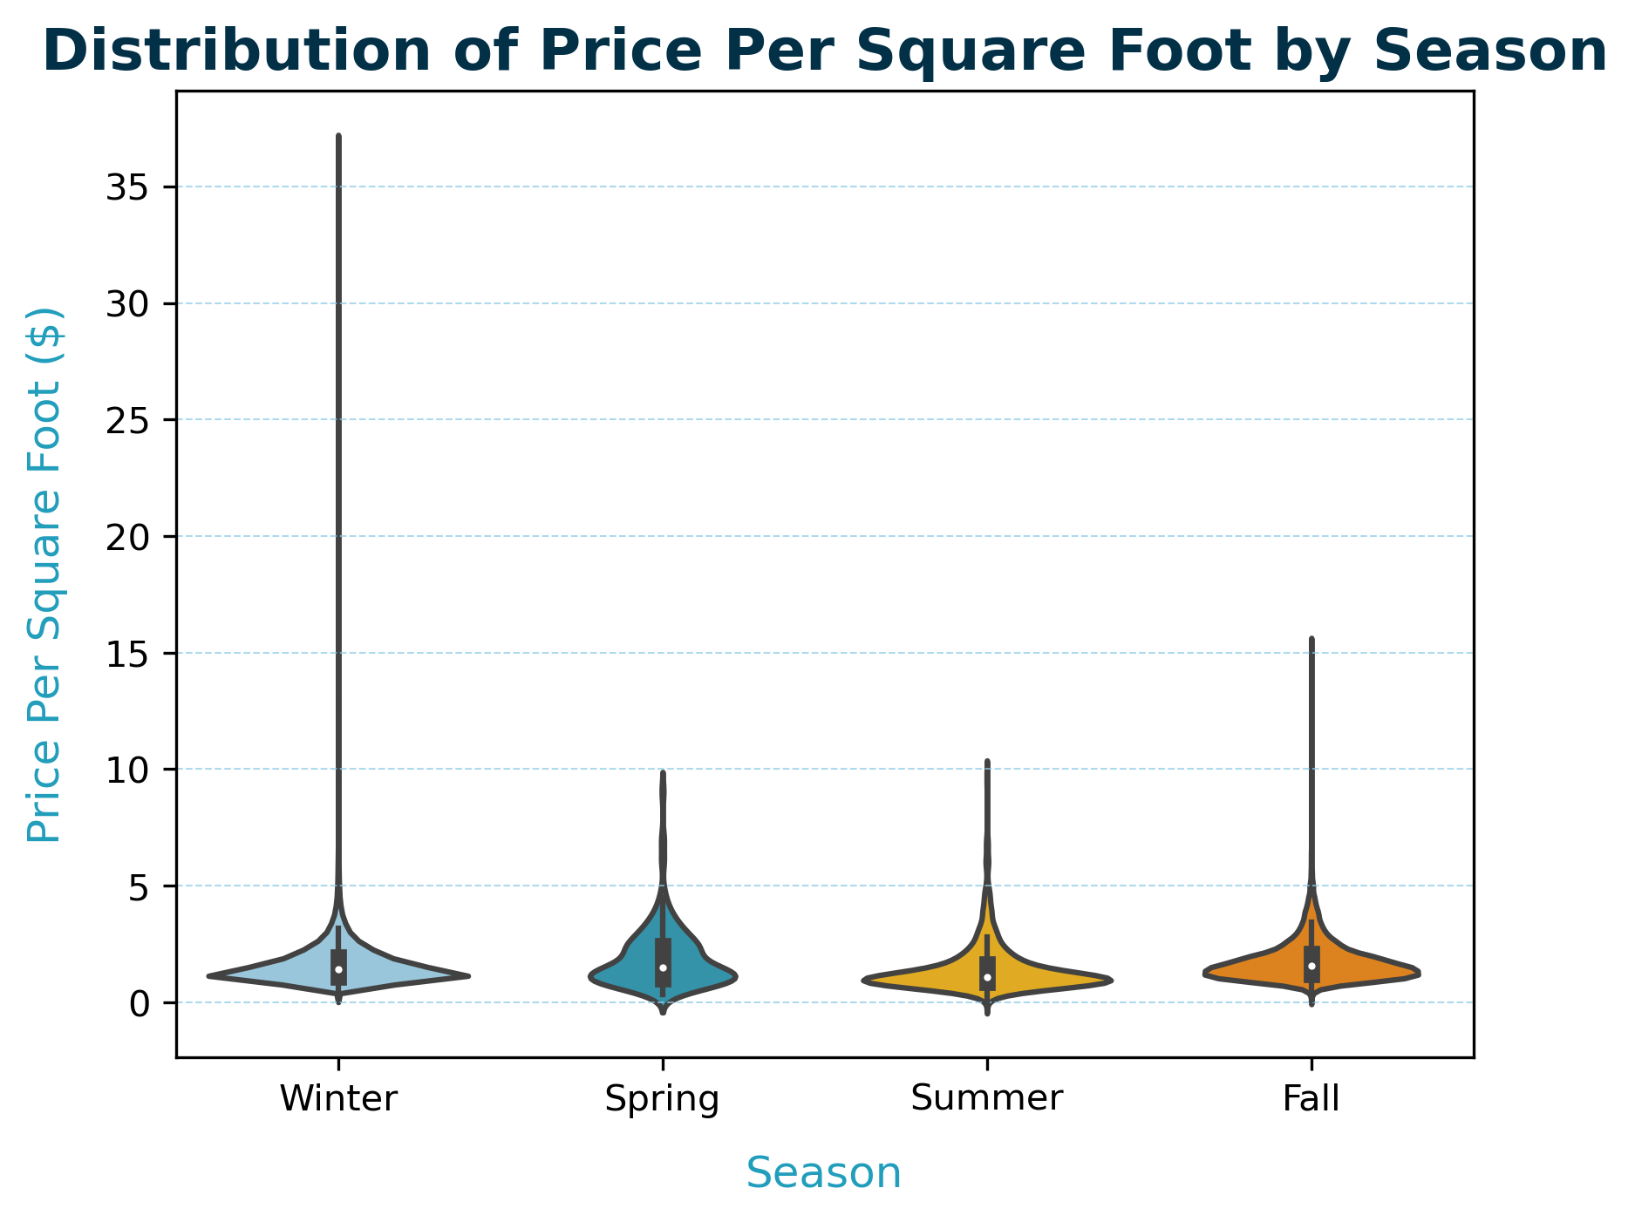
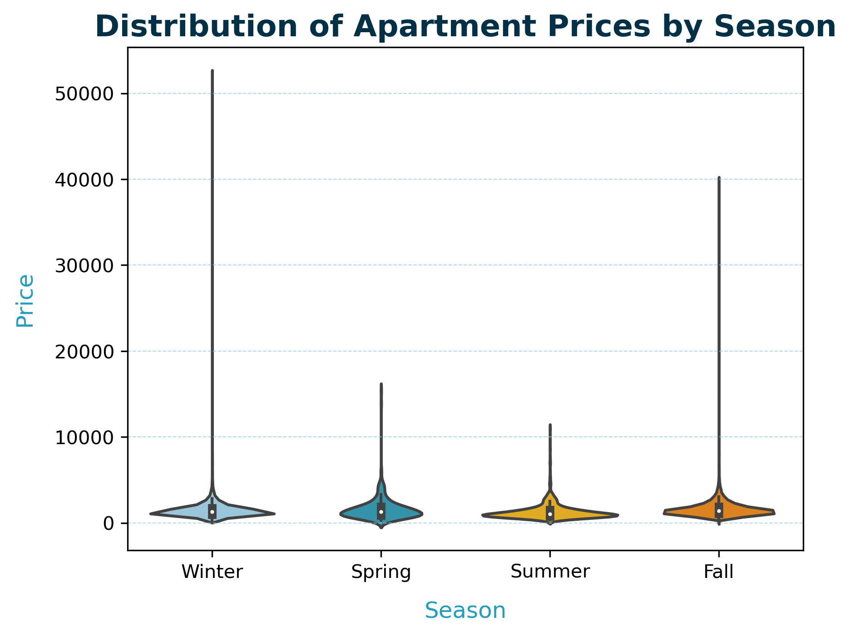
Seasonal Distribution: Price per Square Foot vs Rental Price
Key Insights
Distributions are skewed with a large clump of lower-priced apartments and a few high-priced outliers
Notes:
The distributions are skewed, with a large number of lower-priced apartments and a few extremely high-priced outliers across all seasons. Median prices (centered white dots) are fairly consistent across seasons, aligning with the bar plot insights showing similar average prices. Spring and Summer have the tightest price ranges, indicating more uniform pricing for units during these seasons. Extreme outliers are present across all seasons but are more pronounced in Winter and Fall. This suggests these seasons may have niche markets for ultra-luxury properties.

Slide 9
Question 2:
How do apartment prices vary between states and cities?

Slide 10
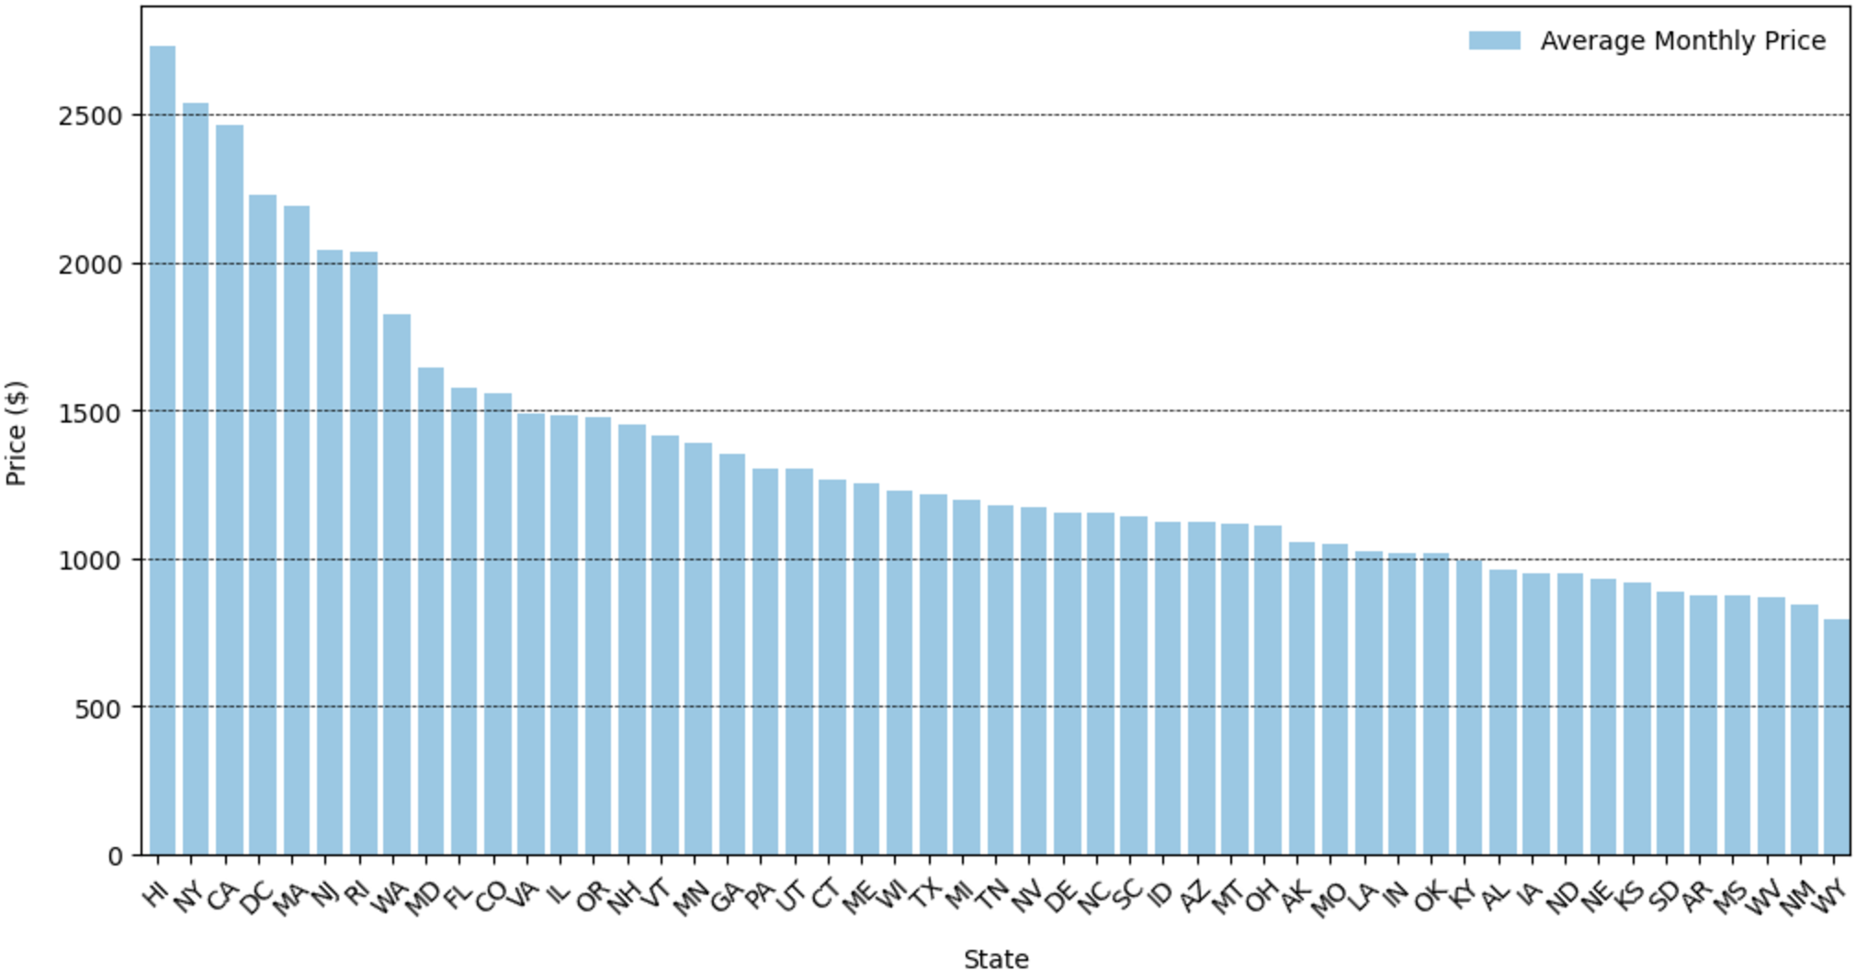
What are the average prices in each state?
Most expensive: Hawaii, New York, California
Least expensive: Wyoming, New Mexico, West Virginia

Slide 11
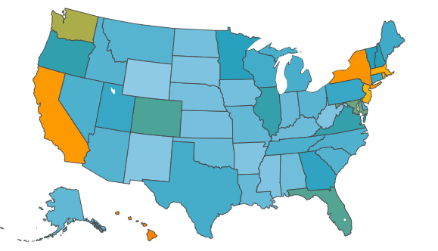

Average Apartment Prices by State in the U.S.

Slide 12
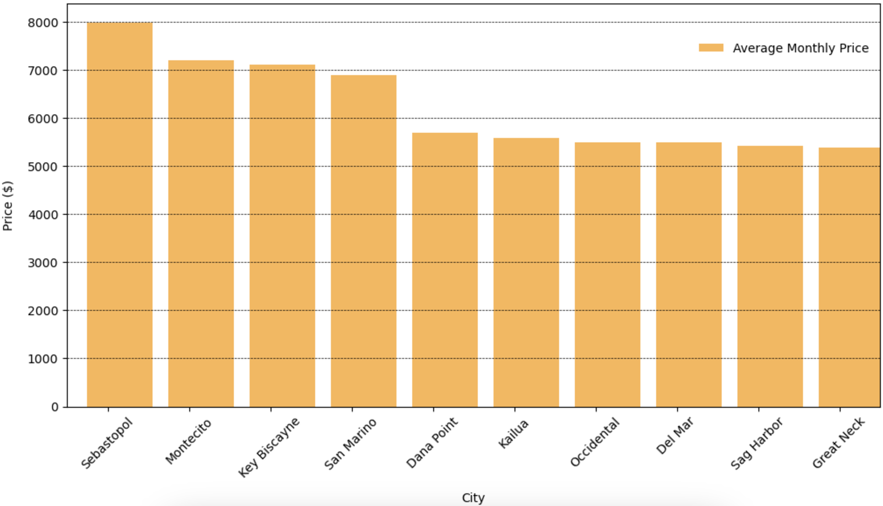
What are the top 10 most expensive cities?
Most expensive: Sebastopol (California), Montecito (California), Key Biscayne (Florida)

Slide 13
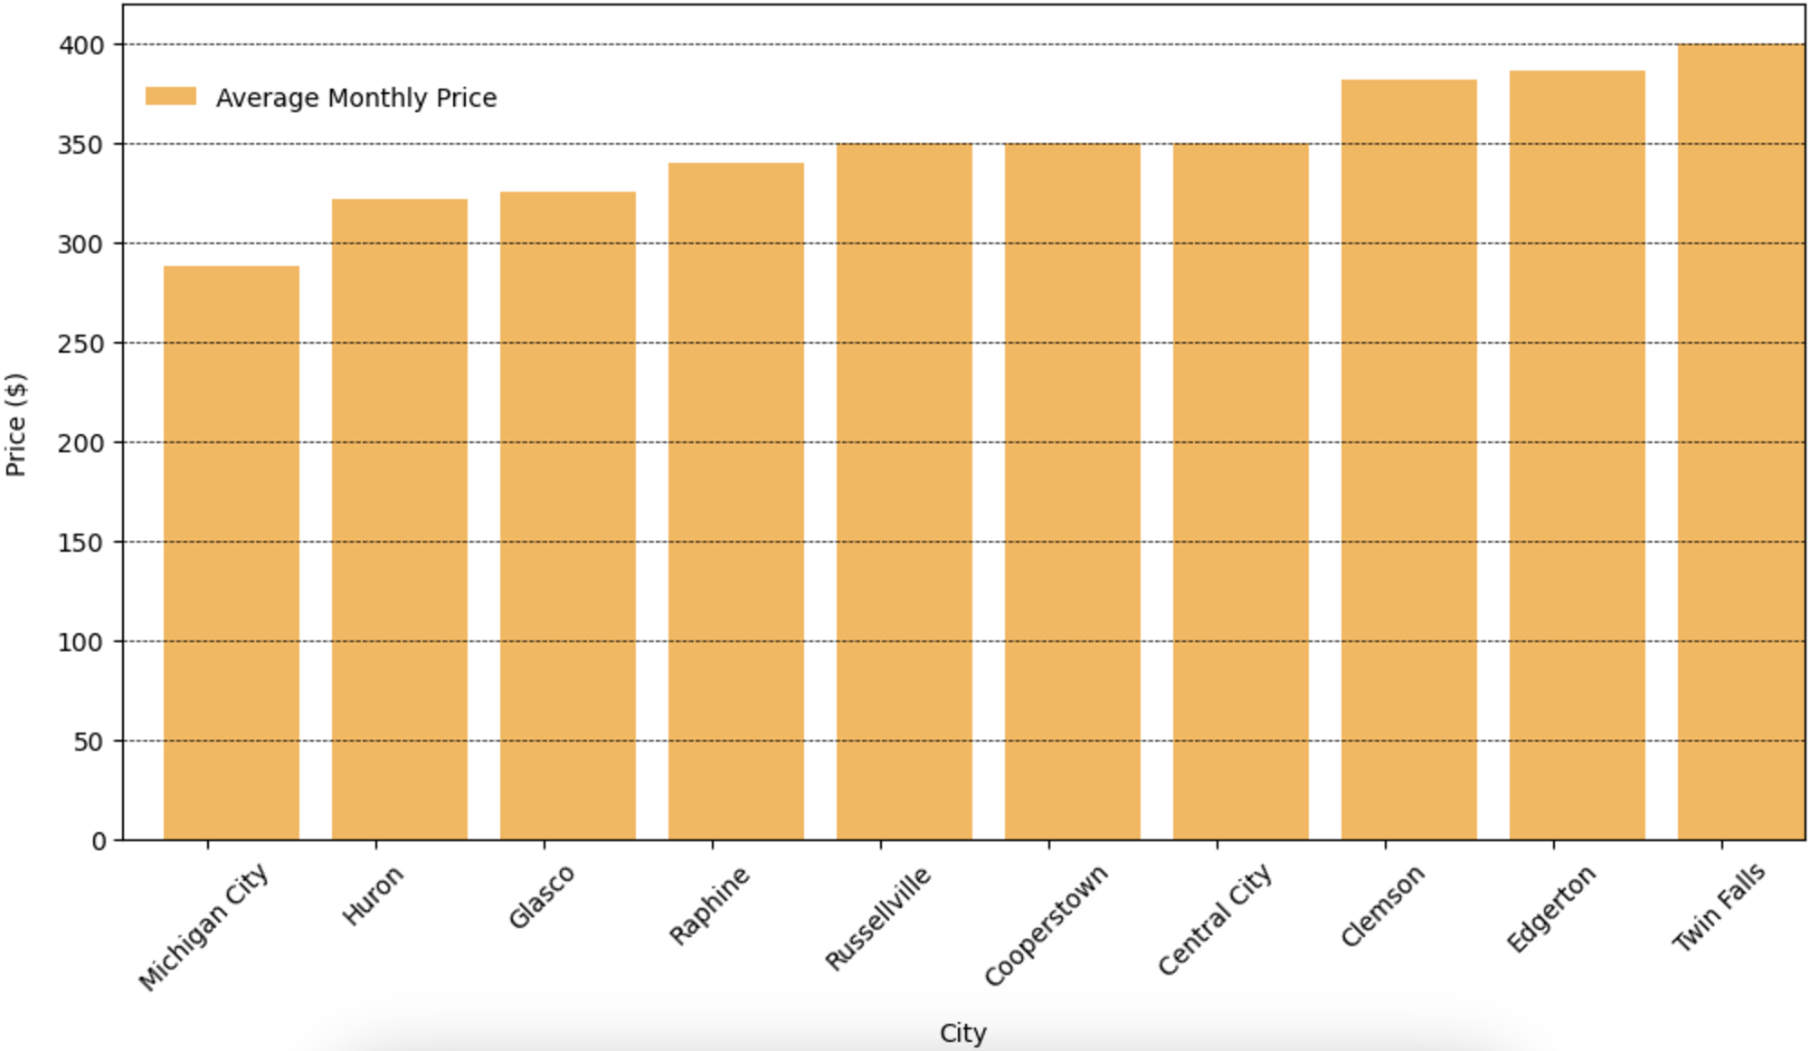
What are the top 10 least expensive cities?
Least expensive: Michigan City (Michigan), Huron (Ohio), Glasco (Kansas)

Slide 14
Question 3:
What is more valuable to renters—having more bedrooms and bathrooms or having more square footage?

Slide 15
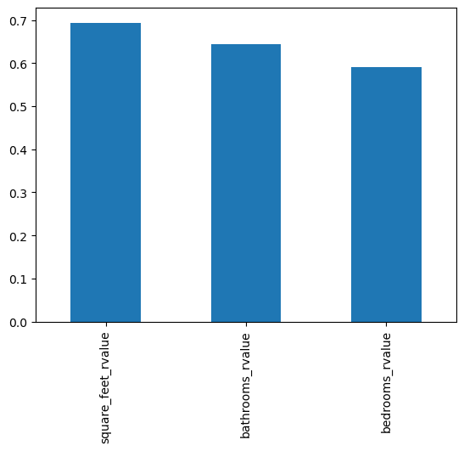
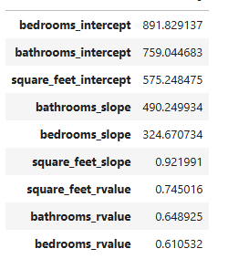
Comparing the apartment’s price and its facilities
Notes:
Bedrooms slope (324.67) indicates that for each additional bedroom, the price of the house increases by approximately $324.67, holding other factors constant.
The slope for Bathrooms (490.25) suggests that for each additional bathroom, the price increases by about $490.25, again holding other factors constant.
The slope for Square Feet (0.92) implies that for each additional square foot, the price increases by approximately $0.92.

Slide 16
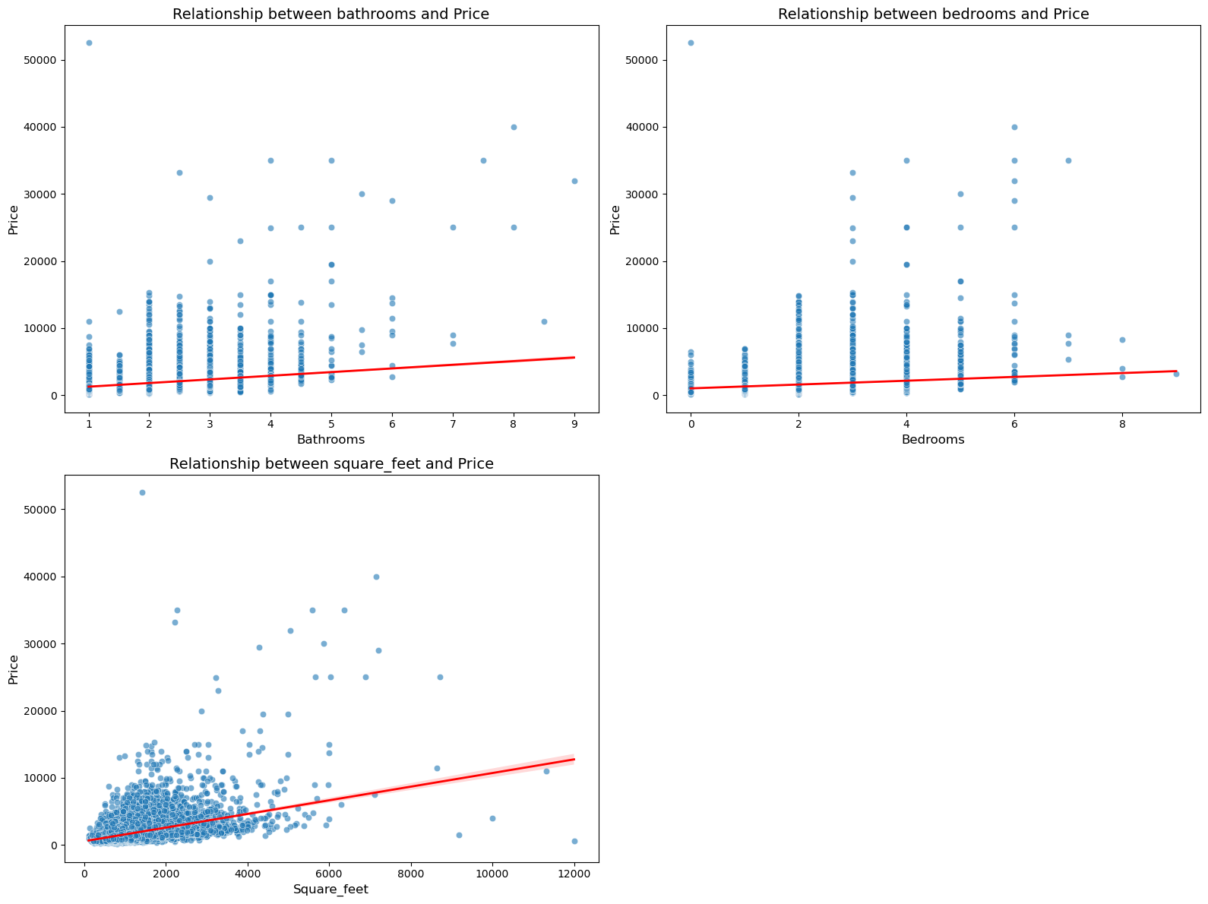
Relationship between bathrooms, bedrooms, square_feet and price
Square Feet is the most significant predictor of price.
Variability in bathrooms and bedrooms impact across cities.
Strong correlations highlight critical factors for pricing strategies.
Notes:
If you're considering the prices of apartments in the USA, it might be useful to know if people prefer having more bedrooms/bathrooms or if they just like having more space.

Slide 17
Biases & Limitations
Limitations:
Timeline:
Old data since 2019
Unequal rows of each season
Missing data / - Outliers
Simplistic Linear Relationships
Geographical Context
Trends / conditions
Biases:
Selection from specific regions, price ranges
Few features focus
High correlation doesn't imply causation.
Regional economic bias.
Notes:
When analyzing and visualizing the impact of features such as "bathrooms," "bedrooms," and "square_feet" on apartment prices, there are several limitations and potential biases to consider:
Missing Data: If some entries for bathrooms, bedrooms, square_feet, or price are missing or incorrect, this can skew the results.
Outliers: Extremely high or low values in the dataset (e.g., luxury apartments or very small spaces) can disproportionately influence regression and correlation analyses.

Slide 18
Regressions:
What variables have the most noticeable regressions?
What kind of regressions appear in our data and what stories do they tell?

Slide 19
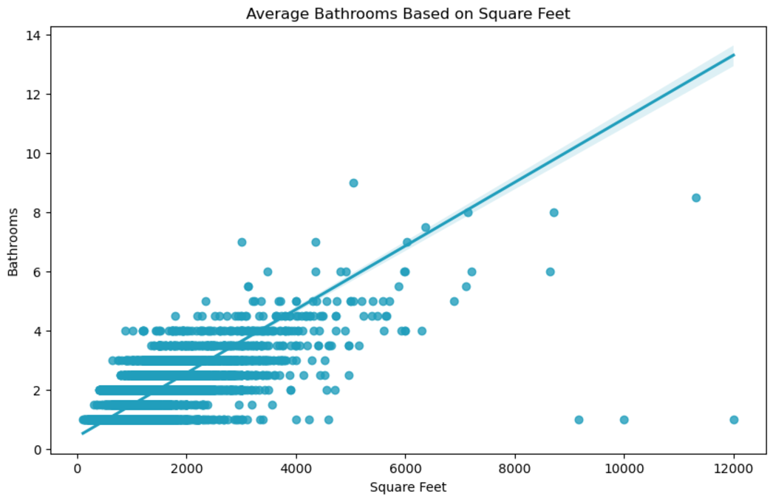
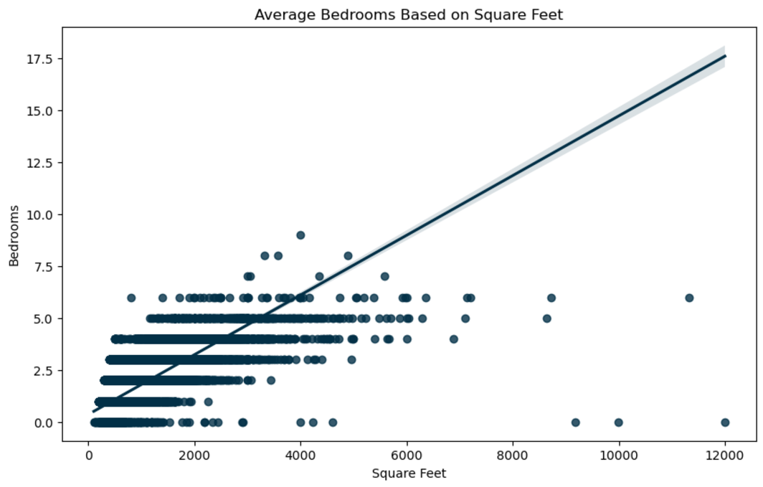
Consistent Positive Regressions
In general terms, more space in an apartment means more rooms
Notes:
Clear positive correlation between square footage and bathrooms / bedrooms. While there is a subtle confidence interval on our regression line. This is because some apartments in our data include large studios with no bedroom at all. And some apartments with many bedrooms, have few bathrooms. *see next slide*

Slide 20
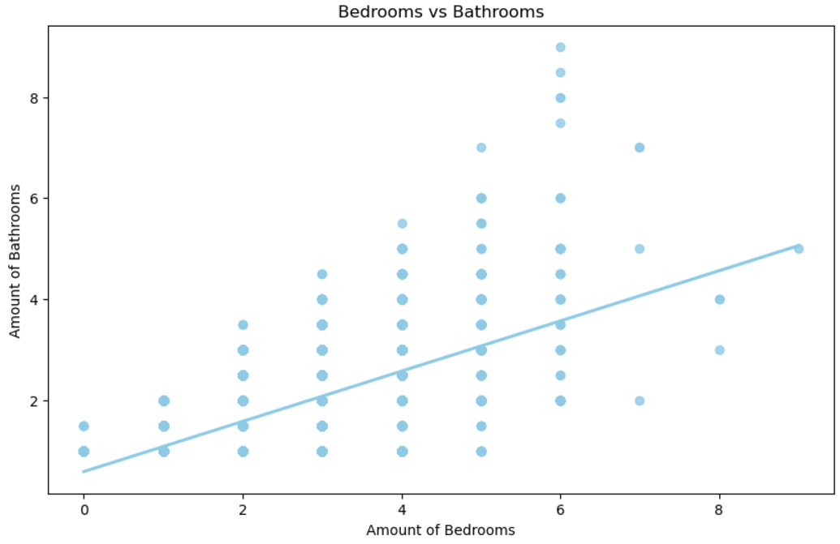
Regression Between Bedrooms & Bathrooms
Notes:
This is a straight forward, positive regression. At the same time, notice the differences between 6 bedroom apartments in particular.

Slide 21
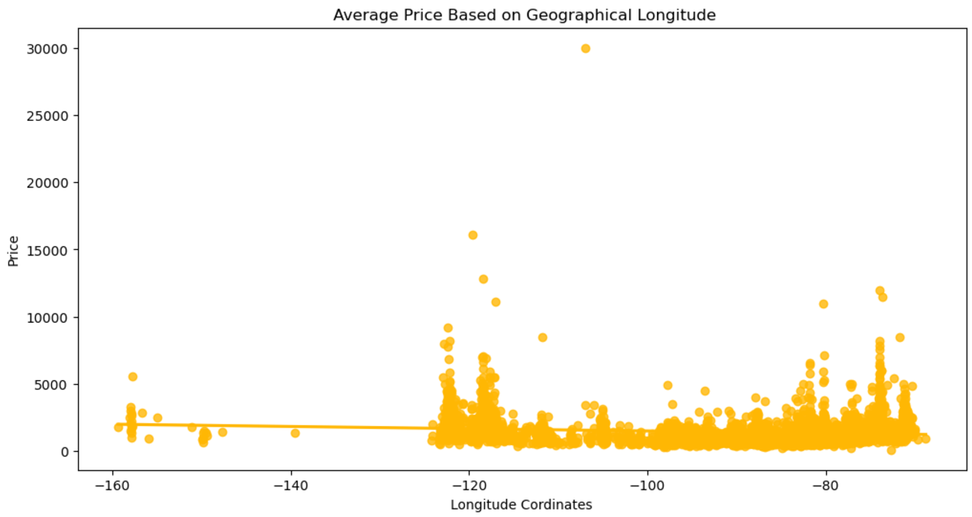
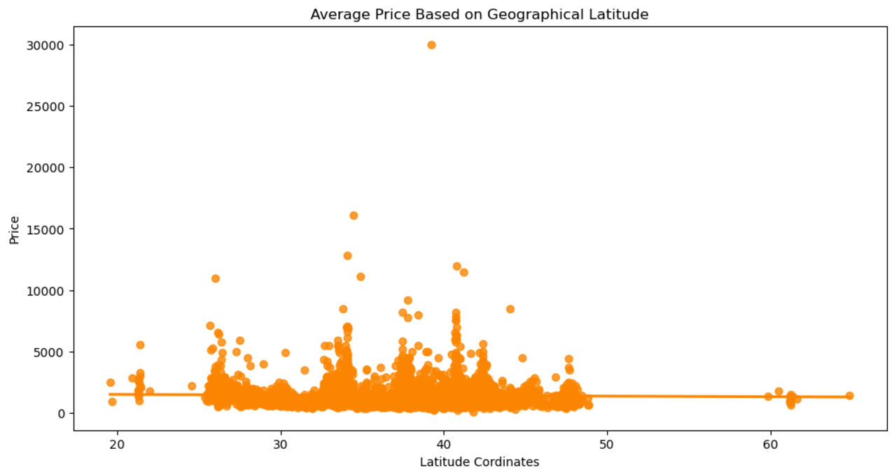
Geographical
Regressions
Notes:
Think about what story is told here even with little info and a flat regression line. Going east to west has little impact on prices. We can see geographical latitude and longitude have no strong connection. This is impacted by outliers, and the fact that some of the most expensive cities are on the west coast, while some of the cheapest are as well.

Slide 22
Conclusion
Question 1: Fall and spring have higher average prices with October being the highest overall
Question 2: California, New York, and Hawaii have the highest state prices while Wyoming, New Mexico and West Virginia have the lowest. Cities with the highest rent prices are: Sebastopol (CA), Monticello (CA), and Key Biscayne (FL). The least expensive cities are: Michigan City (MI), Huron (OH), and Glasco (KS).
Question 3: Renters value more square footage above amount of bathrooms and bedrooms

